Slide 1
Workshop: the DH&HML package
Chuhong Lin, PhD.
Research Fellow
School of Chemistry, Chemical Engineering and Biotechnology, Nanyang Technological University, Sinagpore

Slide 2
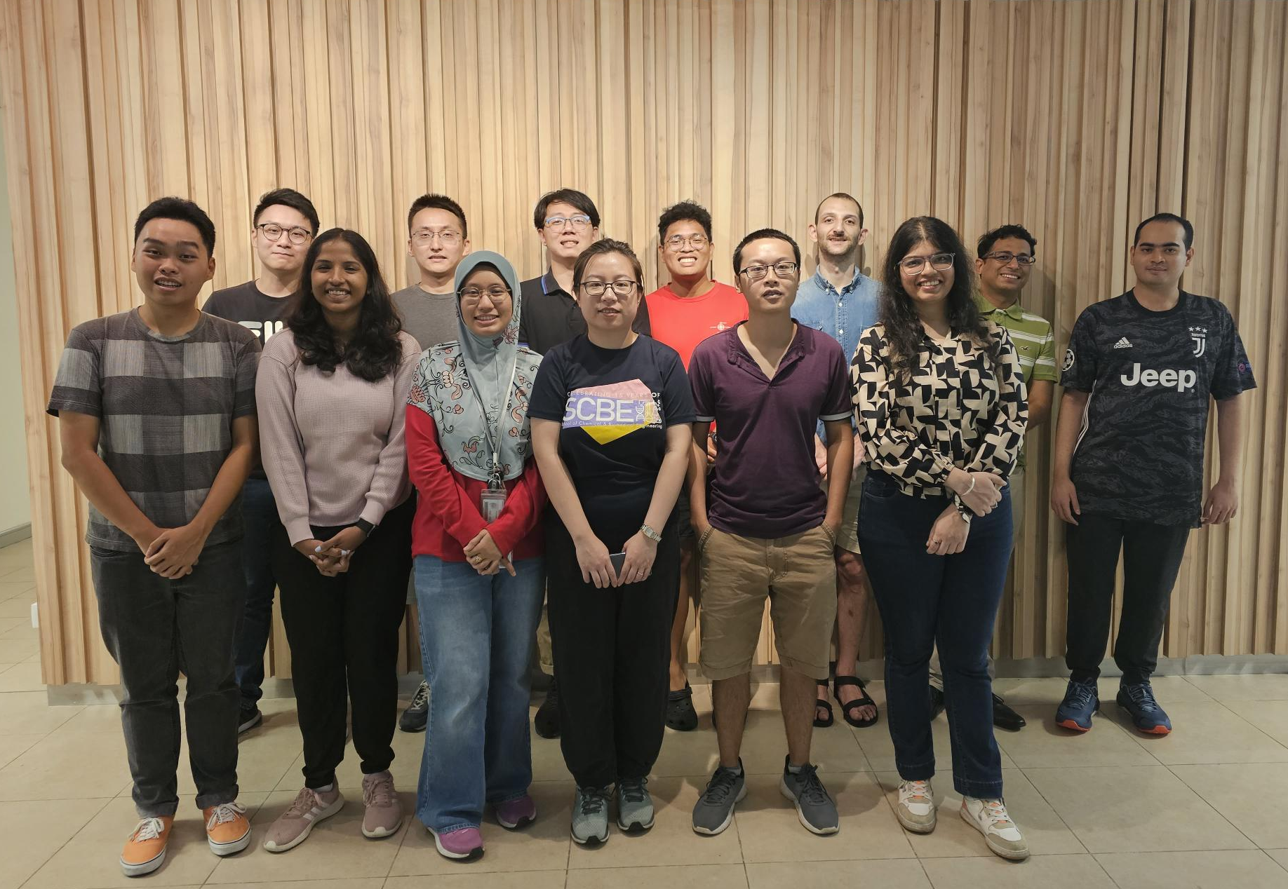


Acknowledgements
Funding
Low Carbon Energy Research Funding Initiative, U2102d2013
High Performance Computing
This research was partially performed on resources of the National Supercomputing Centre, Singapore (https://www.nscc.sg).

Slide 3


About Me
Doctor of Philosophy in Physical and Theoretical Chemistry
University of Oxford, UK
Research focus: Investigating the influence of non-catalytic factors on electrochemical reactions by multiscale kinetics simulation.
“University of Catford”
Research Fellow
Nanyang Technological University, Singapore
Research focus: Catalyst design for the dehydrogenation of liquid organic hydrogen carriers by machine learning and first principle computation.
“Nanyang Catnological University”

Slide 4
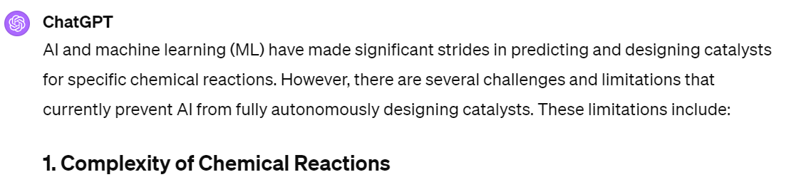
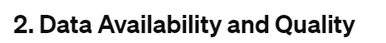
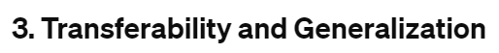
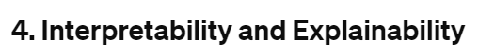
If AI can design logos, can they also design catalysts?
These are also the obstacles that we are facing in catalyst design, especially for the heterogeneous catalytic reactions of large, organic molecules.
Understand the design principles of the DH&HML package.
Goals of study
Practice to train your own machine learning models and calculate reaction kinetics.
Apply the DH&HML model to other dehydrogenation or hydrogenation reactions.

Slide 5
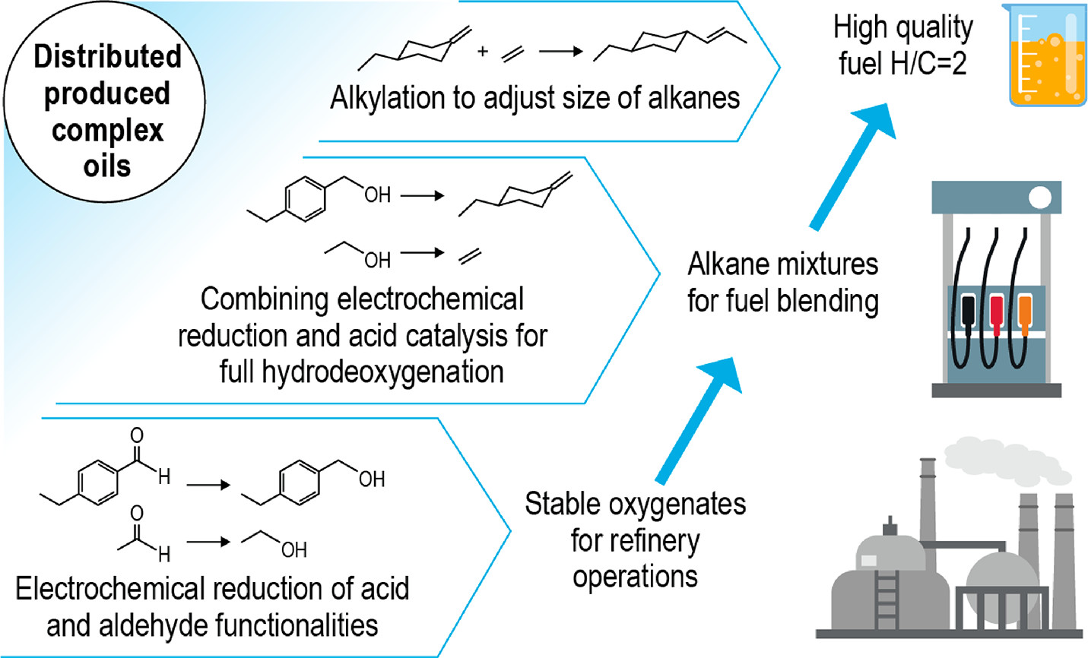
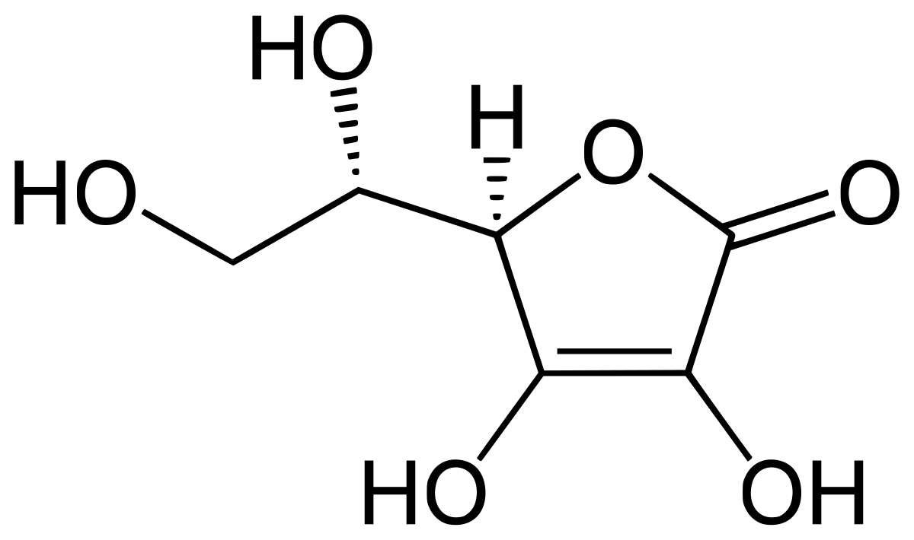
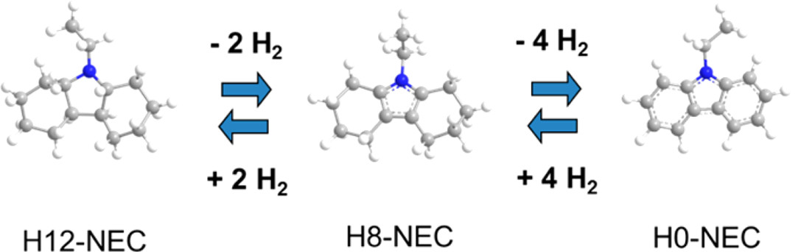
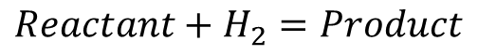
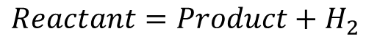
What is the DH&HML package?
Dehydrogenation/hydrogenation (DH&H) is to remove/add hydrogen from the reactant molecule.
DH
$$Reactant=Product+H_{2}$$
H
$$Reactant+H_{2}=Product$$
Applications
Synthesis of pharmaceuticals and fine chemicals
Hydrogen transport and storage
Fuel production
Vitamin C
Acc. Chem. Res. 2017, 50, 1, 74-85
Chem. Rev. 2020, 120, 20, 11370-11419

Slide 6
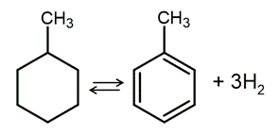
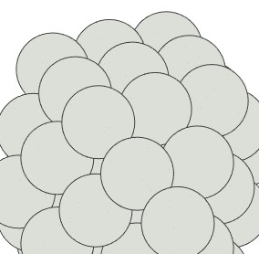
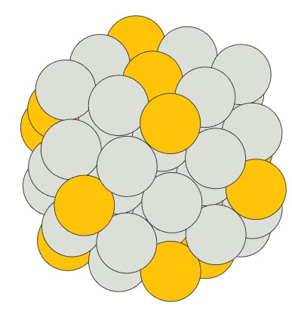
Catalyst design by computational method
Computational Chemistry
Reaction Kinetics Modelling
Catalyst Screening
Reaction energies
Reactivity and selectivity
Composition, structure, etc.
Accelerated by machine learning
High-throughput calculation for complex reactions
Example reaction
Methyl cyclohexane
MCH, C₇H₁₄
Toluene
TOL, C₇H₈
Challenges
Pt-M bimetallic nanoclusters
Pt nanoclusters
Expensive data collection cost
Adding promoters: M
Complex adsorption interaction → many affecting factors

Slide 7
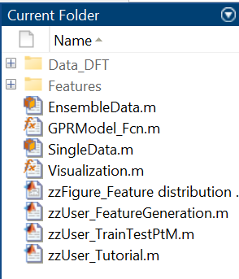
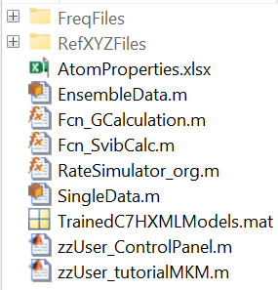
What is included in the DH&HML package?
Install MATLAB
Two folders: 1) adsorption energy (ΔE_{ads}) prediction by machine learning (ML);
2) catalyst screening by ML predicted energy + microkinetic modelling (MKM)
(ML: Machine Learning)
(MKM: Microkinetic Modelling)
ML folder
MKM folder
2
1
6 reaction intermediates
Calculating reaction kinetics
Reactivity (Turnover frequency per site)
ΔE_{ads}
Selectivity (Surface coverage of intermediates)
Mapping over different Pt-M nanoclusters
3

Slide 8
Content
Machine learning
Microkinetic simulation
Data collection
Calculation of reaction rate constants
Gaussian process regression
Reaction rate equations
Active learning
Application of ML model on MKM
Training data structure
Activation barrier estimation
Feature selection
Numerical simulation
Practice: training a GPR model
Validation
Homework: train a GPR model to predict the adsorption energy of C₇H₁₃.
Practice: calculate TOF for a new catalyst
Homework: screen over Pt-Ag nanoclusters.

Slide 9

Design principle of the DH&HML package I. Machine learning
Goal of the ML model: ΔE_{ads} prediction over different Pt-M bimetallic nanoclusters
ML model
Input: Structure
Output: Adsorption energy
Information of adsorbate and catalyst
ML model training
Training data collection
Feature selection
Parameter fitting
Validation and testing
Both input and output from Density Functional Theory (DFT) calculation.
Numbers to represent the input information.
Suitable ML algorithm and the parameters or hyperparameters involved.
No overfitting, accuracy, generality, transferability, etc.

Slide 10
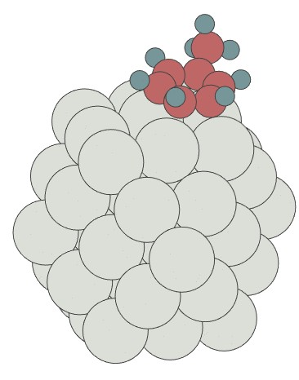
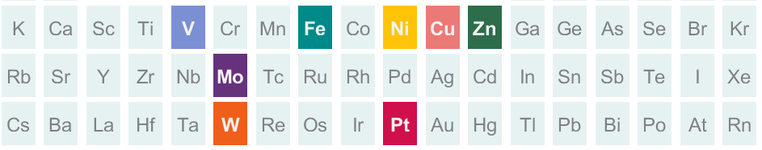
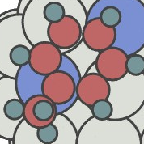
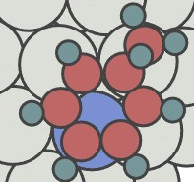
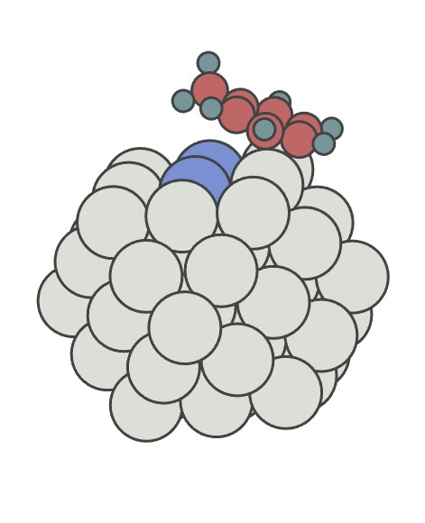
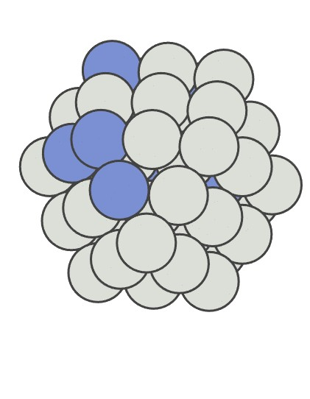
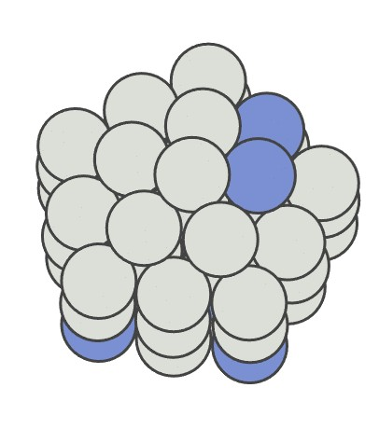
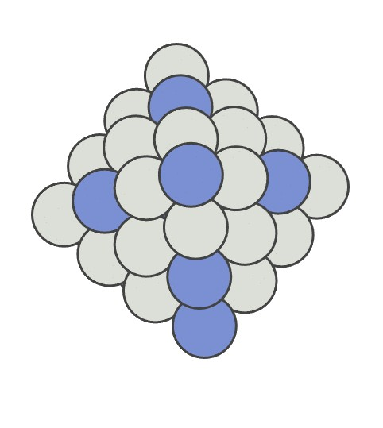
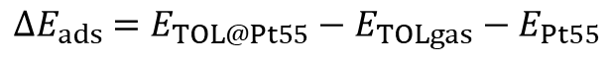
Training data collection
TOL adsorbed on Pt₅₅
Use the adsorption energy of toluene as an example.
DFT computation:
ΔE_{ads}
+
optimised structure
Single adsorbate → easier to build an accurate model
Toluene → the most important intermediate (selectivity and reactivity)
Material space
Pt-M bimetallic nanoclusters
$${∆E}_{ads} =E_{TOL@Pt55}−E_{TOLgas}−E_{Pt55}$$
As many variables as possible (Generality)
As less calculation as possible (Cost)
Composition
Active site geometry
Active site (local)
Nanoparticle morphologies (global)
Facet
Coordination environment
Morphology
4-fold (100)
3-fold
(111)
2-atoms
edge
CUBO
55 atoms
DEC
55 atoms
OCT
44 atoms
Size

Slide 11


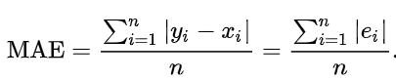
Data collection
1) Manually sampling over the high-dimensional material space, e.g. 5 compositions * 5 site geometry *...
Empirical data sampling design: using our chemical knowledge to decide the weight of each variable
2) Active learning: efficient mapping over the high-dimensional material space
GPR: Gaussian Process Regression
Initial data collection
Uncertainty: Uncertainty of a prediction
Training data pool
~ Confidence interval of a normal distribution
Higher uncertainty → add the new data to the training dataset
ML model (GPR)
DFT
MAE < 0.15 eV
uncertainty
New testing data
MAE: mean absolute error
Data with high uncertainty

Slide 12
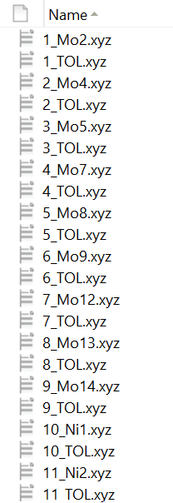
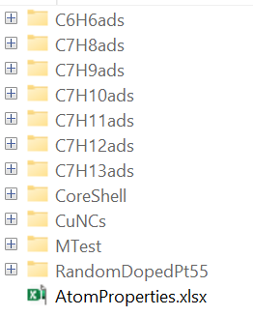
DFT calculation: Quantum ESPRESSO
Structure file: .xyz file → easy to operate by MATLAB
Bare nanoclusters
index_name of the NC.xyz
ML folder
TOL adsorbed nanoclusters
index_TOL.xyz
RandomDopedPt55 folder stores 131 pairs of data.
Data_DFT folder stores all the DFT calculated data in the MCH-TOL project.
The data in the Data_DFT folder are collected by manual sampling, not by active learning.

Slide 13
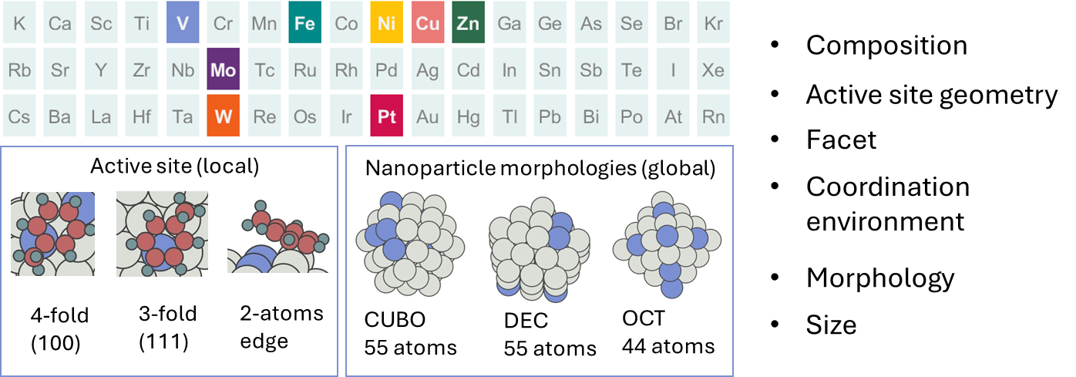
Feature selection
Requirement of features/descriptors
ML
Relevance
How to present this structure by a vector of numbers?
Uniqueness
ΔE_{ads}
Simplicity
Generalization Ability
1) Physics-inspired feature selection: determining features based on our understanding
Better explainability
Smaller dataset size requested
What atomic properties affect the adsorption energy most significantly?

Slide 14
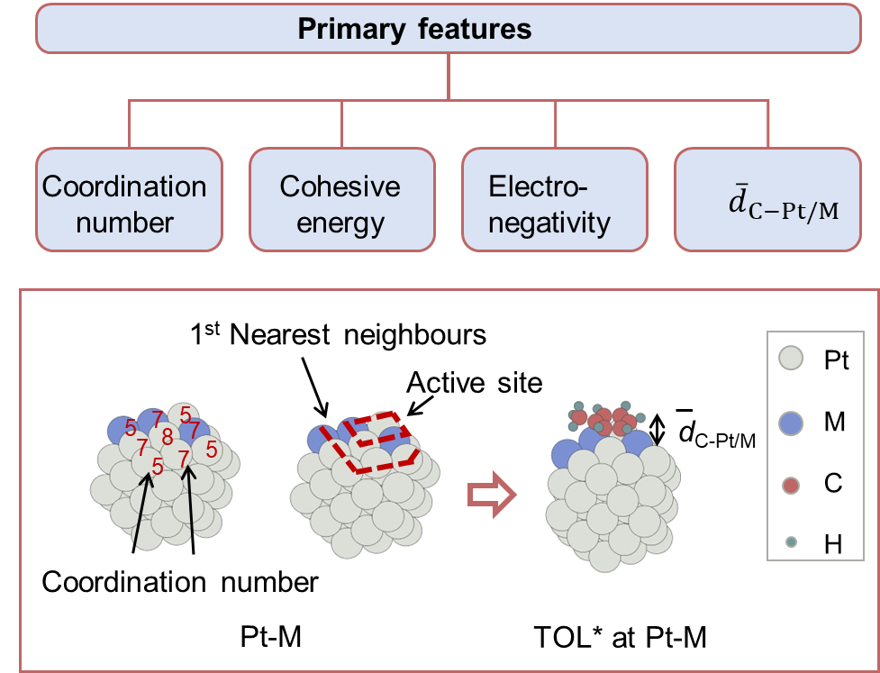
Physics-inspired feature selection: knowledge from literatures on chemisorption
Which atomic properties are correlated with chemisorption?
Cohesive energy
Electronegativity
Coordination number
Bond information
How many atoms should be taken into consideration?
Active site
(the atoms directly interacting with the adsorbate)
1st nearest neighbours
(the atoms attaching with the active site atoms)
J. Phys. Chem. Lett. 10, 1852–1859 (2019)
ACS Catal. 14, 874–885 (2024)
ACS Catal. 2, 12–16 (2012)
ACS Catal. 13, 13663–13671 (2023)
Nat. Commun. 11, 1196 (2020)
Adv. Sci. 10, 2207644 (2023)

Slide 15
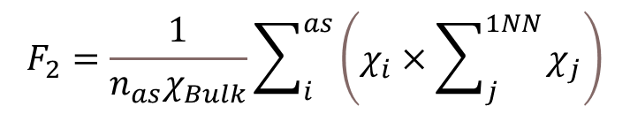
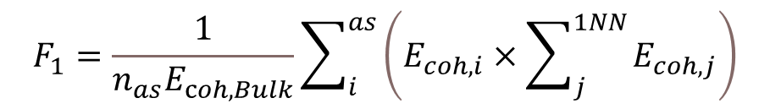
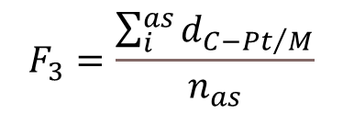
Using individual properties may not give the optimal prediction performance.
For alloys, we need to represent the ligand effect.
Pt₅₅: all metal atoms are Pt.
$$F_{1}=\frac{1}{n_{as}E_{coh,Bulk}}\sum_{i}^{as}{\left(E_{coh,i}×\sum_{j}^{1NN}{E_{coh,j}}\right)}$$
Pt-M: for each metal, the ligand metal atoms around it may not be the same as the host metal atom, which causes a d-orbital shift of the host metal.
$$F_{2}=\frac{1}{n_{as}χ_{Bulk}}\sum_{i}^{as}{\left(χ_{i}×\sum_{j}^{1NN}{χ_{j}}\right)}$$
The d-orbital shift was regarded as the primary cause of changes in chemisorption due to ligand effects.
$$F_{3}=\frac{\sum_{i}^{as}{d_{{C−Pt}/M}}}{n_{as}}$$
J. Chem. Phys. 120, 10240–10246 (2004)
Chem 6.11 (2020): 3100-3117
n_{as}: the number of active site
Each Pt-M bimetallic nanocluster → a unique [F₁, F₂, F₃] fingerprint vector

Slide 16
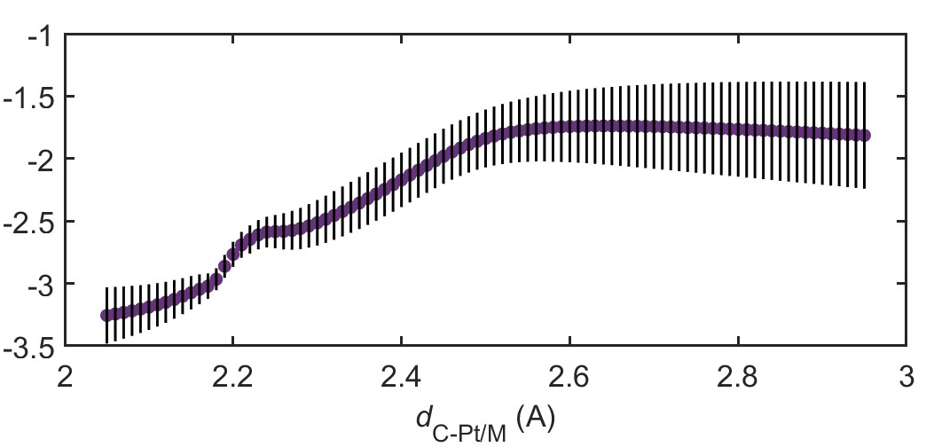
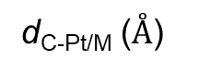
Cohesive energy E_{coh} and electronegativity χ are all collected from database/textbooks.
Coordinate number is calculated from the nanoparticle morphology.
For training data, the average bond length is obtained from DFT optimised .xyz file.
But for testing data, this property is treated as an variable, from 2 to 3 Å.
Minimal uncertainty point is regarded as the prediction result.
Uncertainty
ΔE_{ads, GPR} (eV)
(2.18, -2.96)
d_{C-Pt/M} ($Å$)
DFT calculation: 2.16 Å and –2.89 eV

Slide 17
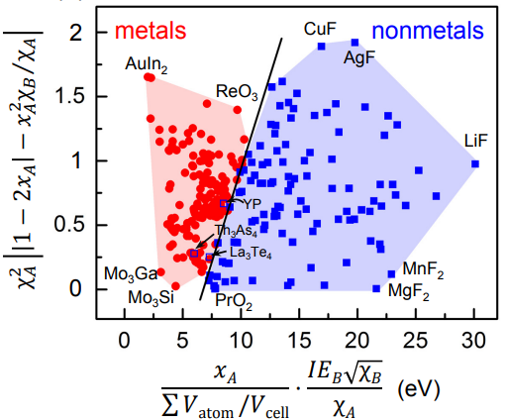
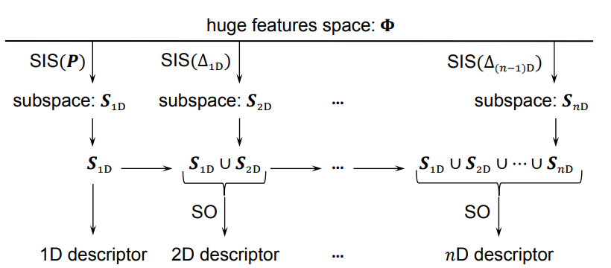
2) Automatic feature selection: Symbolic regression, e.g. SISSO.
List all the possible atomic properties: electronegativity, element number, atomic radius, etc.
Determine the most correlated properties
+
Provide the mathematical expression of descriptors
Phys. Rev. Materials, 2, 083802

Slide 18
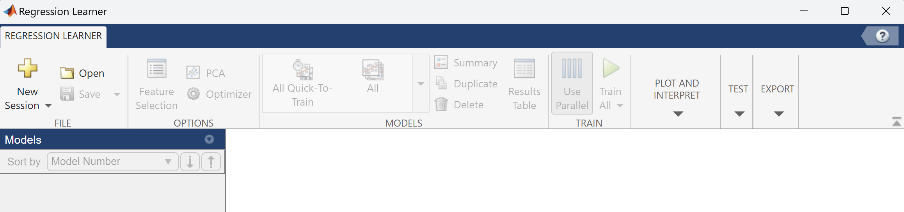
Parameter fitting
Gaussian process regression
y = GPR(x)
Input x: 131 data * 3 features
Input y: 131 ∆E_{ads}
How to evaluate the performance of the model:
Small error
High correlation
Not overfitted
Transferable
GPR model
 | F₁ | F₂ | F₃
1
2
…
131
MATLAB built-in function: fitrgp

Slide 19
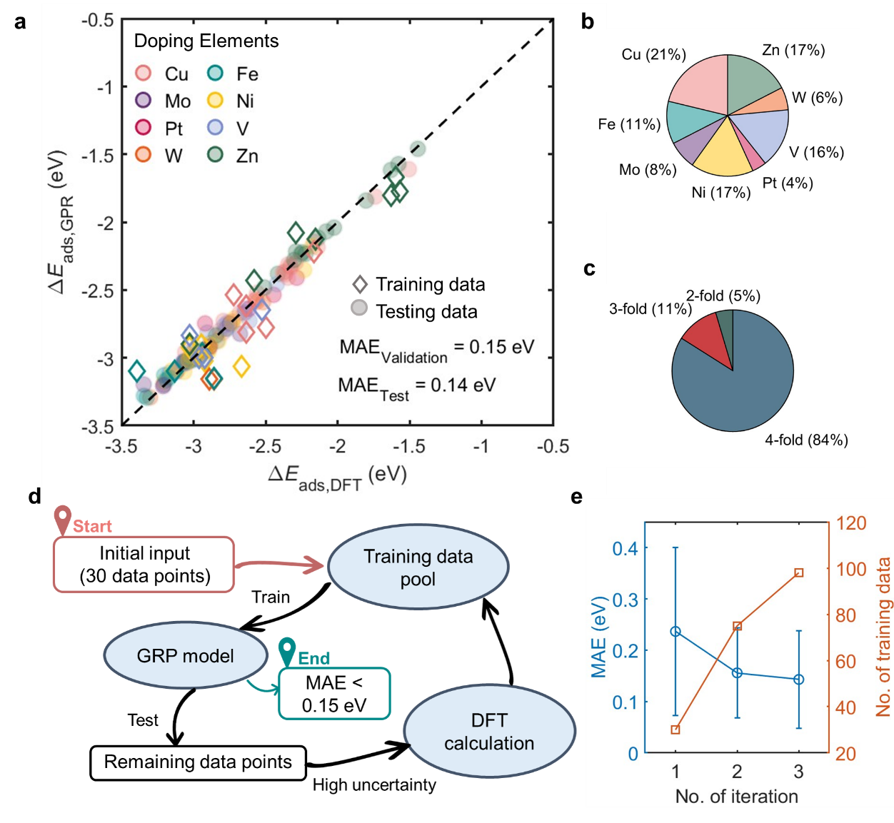
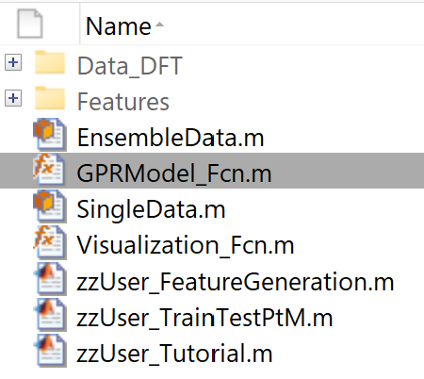
131 data points
80%: Training
20%: Testing
5-fold validation
This is the function to call when you want to train a GPR model.

Slide 20
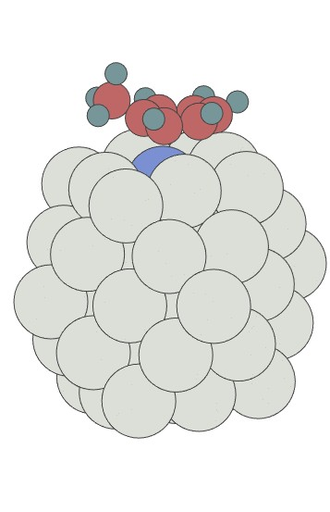
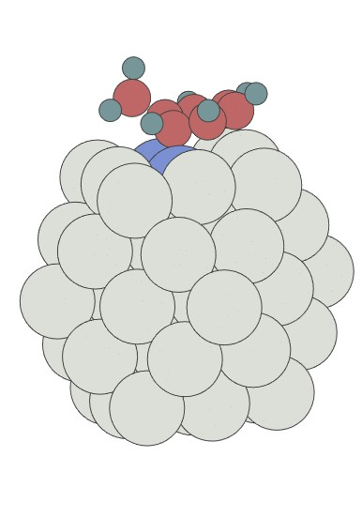
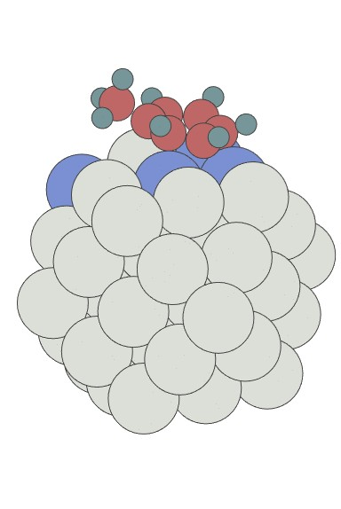
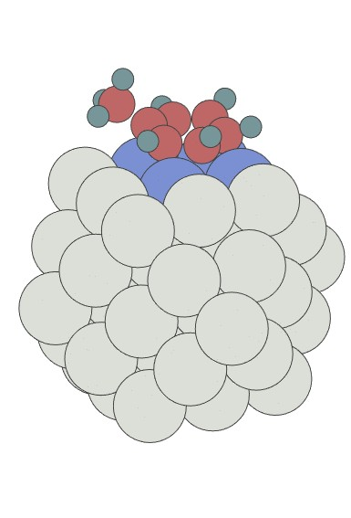
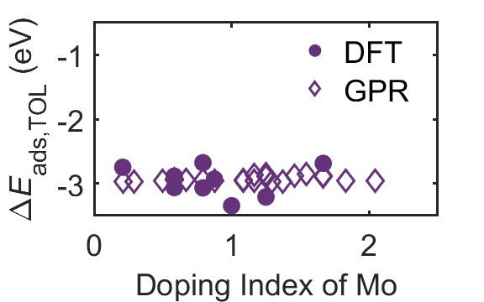
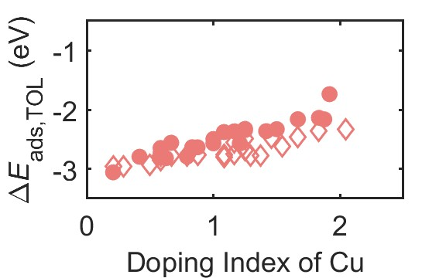
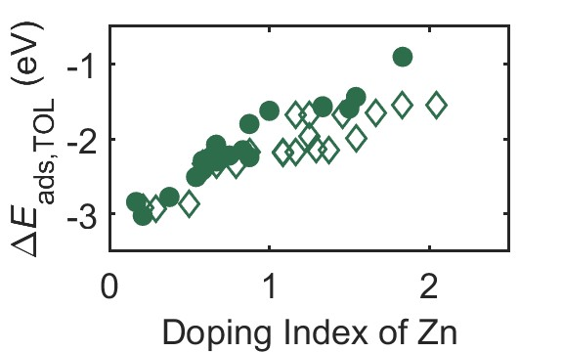
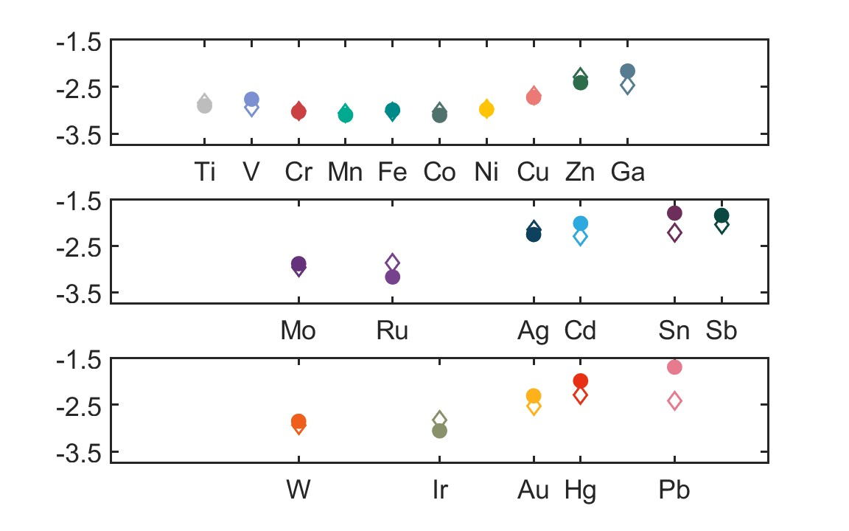
Transferability testing
a
Doping index increases
GPR model → New data
MAE = 0.19 eV
b
Period 3
: used in training data
M
M
: new element
ΔE_{ads, TOL}(eV)
Period 4
Change elements
Pb
...
Ti
Co
Au
Cd
Period 5

Slide 21
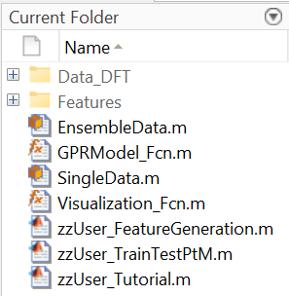




Practice: How to train a GPR model predicting adsorption energy
ML folder
Use class SingleData and EnsembleData to extract features and generate fingerprints
Training data from DFT calculation
Fingerprints of the training dataset
GPRModel_Fcn is used to train a GPR model.
Visualization_Fcn is used to view a .xyz file.
Scripts to use the above functions to convert .xyz files into fingerprints and train a GPR model.
Edit these functions when you want to change the criterion and definitions of features and fingerprints.

Slide 22
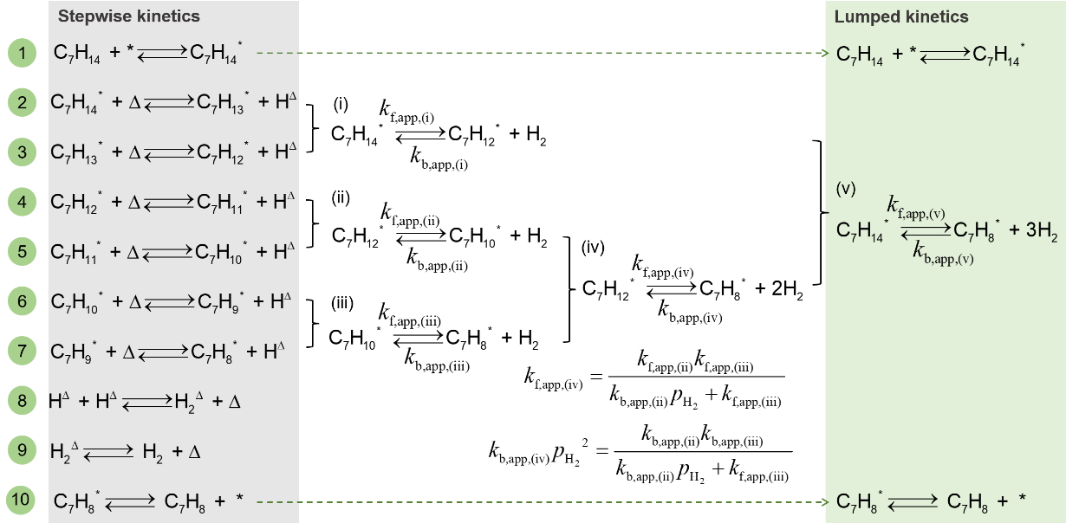
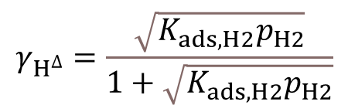



Design principle of the DH&HML package II. Microkinetic model
Dual-site assumption: C₇H_{x}* and H^{Δ} occupy different sites
A* + Δ = B* + H^{Δ}
$$r_{A^{∗}−B^{∗}=k_{f,A−B}θ_{A}{γ_{∆}−k_{b,A−B}θ}_{B}γ_{H} }$$
Non-linear ordinary differential equation (ode)
H-H recombination is relatively faster than other reactions.
$$γ_{H^{∆}}=\frac{\sqrt{K_{ads,H2}p_{H2}}}{1+\sqrt{K_{ads,H2}p_{H2}}}$$
$$γ_{∆}=\frac{1}{1+\sqrt{K_{ads,H2}p_{H2}}}$$
$\frac{∂θ_{C_{7}H_{x}}}{∂t}=k_{ads}θ_{∗}p_{C_{7}H_{x}}−k_{des}θ_{C_{7}H_{x}}{−k}_{f}θ_{C_{7}H_{x}}γ_{∆}+k_{b}θ_{C_{7}H_{x−1}}$ $γ_{H^{∆}}$
x7
$$\frac{∂n_{C_{7}H_{x}}}{∂t}= \left(n_{in}v_{in}−n_{C_{7}H_{x}}v_{out}\right)+n_{as}\left(−k_{ads}θ_{∗}\frac{n_{C_{7}H_{x}}RT}{V}+k_{des}θ_{C_{7}H_{x}}\right)$$
x2
$$θ_{∗}=1−\sum_{8}^{14}{θ_{C_{7}H_{x}}}$$
Continuous stirred-tank reactor

Slide 23





Calculate reaction rate constants from DFT calculated energies
$$K_{eq}=e^{−\frac{∆G_{}}{RT}}=\frac{k_{f}}{k_{b}}$$
∆G : reaction energy
∆G = G_{products} – G_{reactants}
∆G_{act} : activation barrier
∆G_{act} = G_{transition state} - G_{reactants}
Equilibrium constant
$$k_{ads,A}=\frac{a}{\sqrt{2πMk_{B}T}}$$
$$k_{des,A}=\frac{k_{ads,A}}{p_{0}e^{−\frac{∆G_{ads,A}}{RT}}}$$
Adsorption-desorption
A + * = A*
Collision theory
a: active site area (m²)
M: molecule mass (kg)
k_{B}: the Boltzmann constant
(1.38x10⁻²³ J/K)
T: temperature
R: the gas constant
(8.314 J/mol/K)
$$k_{A−B, f}=\frac{k_{B}T}{h}e^{−\frac{∆G_{A−B, act}}{RT}}$$
Surface reaction
A* + Δ = B* + H^{Δ}
$$k_{A−B,b}=\frac{k_{A−B,f}}{e^{−\frac{∆G_{A−B}}{RT}}}$$
Transition state theory
Chem. Rev. 2021, 121, 1049−1076

Slide 24



A + * = A*
(*: Pt-M site)
$${∆E}_{ads,A}= E_{A∗}−E_{gas,A}−E_{Pt−M}$$
GPR model prediction
?
k = function(∆G, ∆G_{act} )
Zero-point energy (ZPE): the ground state energy.
$${∆G}_{}= {∆E}_{}+ {∆E}_{ZPE }−{T∆S}_{}$$
ZPE and S are assumed to be independent of active site composition in the simulation.
Adsorption-desorption
$${∆G}_{ads,A}= {∆E}_{ads,A}+ {∆E}_{ZPE,A }−{T∆S}_{ads,A}$$
$${∆S}_{ads,A}= S_{A∗}−S_{gas,A}$$
H adsorption energy is assumed to be independent of active site composition.
Surface reaction
$${∆E}_{A−B}= {∆E}_{ads, B}+ {∆E}_{ads, H}−{∆E}_{ads, A}+\left(E_{gas,B}+0.5E_{gas,H2}−E_{gas,A}\right)$$
A* + Δ = B* + H^{Δ}
ΔE_{ZPE, A-B} is E­_{ZPE,B*} – E_{ZPE,A*} – E_{ZPE,HΔ} and ΔS_{A-B} is S_{B*} - S_{A*} - S_{HΔ}.
DFT-calculated reference active site on Pt₅₅ (4-fold site on the 100 facet)
GPR model
+
k = function(∆G , ∆G_{act} )
DFT-calculated ZPE and S terms
∆E_{ads} terms

Slide 25


$${∆G}_{A−B,act}= E_{TS∗}−E_{A∗}+ E_{ZPE, TS∗}−E_{ZPE,A∗} −T\left(S_{TS∗}−S_{A∗}\right)$$
We assumed that the transition state’s ZPE and S are also independent of the active site composition.
$${∆G}_{A−B,act}={∆E}_{A−B,act}+ E_{ZPE, TS∗}−E_{ZPE,A∗} −T\left(S_{TS∗}−S_{A∗}\right)$$
Constant term for a given A → B step, calculated once via DFT on the reference site.
$${∆E}_{A−B,act}={a×∆E}_{A−B}+b$$
Brønsted−Evans−Polanyi (BEP) Relation
a, b are coefficients, which can be fitted from the six C-H breakage steps calculated on the reference active site.
DFT-calculated reference active site on Pt₅₅ (4-fold site on the 100 facet)
GPR model
BEP relation
k = function(∆G, ∆G_{act})
+
+
rate, θ

Slide 26


DFT calculated free energy diagram
Gibbs free energy G
Pt₅₅ nanocluster
Pt(100) facet
Reaction rate constants k
Temperature: 600 K
Pressure: 1 bar (MCH)
ML model → E, enthalpy
Transition states
G = E – T*S
T: temperature
S: entropy
Reaction intermediates
Entropy of gas-phase molecules: Ideal gas assumption
Entropy of adsorbates: Harmonic limit
Quantum ESPRESSO + Atomic Simulation Environment (ASE)
https://wiki.fysik.dtu.dk/ase/ase/thermochemistry/thermochemistry.html

Slide 27





Numerical simulation: Finite difference method
$\frac{∂θ_{C_{7}H_{x}}}{∂t}=k_{ads}θ_{∗}p_{C_{7}H_{x}}−k_{des}θ_{C_{7}H_{x}}{−k}_{f}θ_{C_{7}H_{x}}γ_{∆}+k_{b}θ_{C_{7}H_{x−1}}$ $γ_{H^{∆}}$
x7
$$\frac{∂n_{C_{7}H_{x}}}{∂t}= \left(n_{in}v_{in}−n_{C_{7}H_{x}}v_{out}\right)+n_{as}\left(−k_{ads}θ_{∗}\frac{n_{C_{7}H_{x}}RT}{V}+k_{des}θ_{C_{7}H_{x}}\right)$$
x2
$$θ_{∗}=1−\sum_{8}^{14}{θ_{C_{7}H_{x}}}$$
Numerical simulation: Self-consistent p_{H2}
$$γ_{H^{∆}}=\frac{\sqrt{K_{ads,H2}p_{H2}}}{1+\sqrt{K_{ads,H2}p_{H2}}}$$
p_{H2} = 0
Odes of C₇H_{x}
p_{H2} = 3*p_{TOL}
$$\left|p_{H_{2}}^{k}{−p}_{H_{2}}^{k−1}\right|<{10}^{−5}$$
$$γ_{∆}=\frac{1}{1+\sqrt{K_{ads,H2}p_{H2}}}$$
No

Slide 28




Validation
Steady state
$\frac{∂θ_{C_{7}H_{x}}}{∂t}<{10}^{−5}$ (user-defined criterion)
Analytical reaction rate expression when TOL desorption is the only rate-determining step:
rate = k_{TOL,des}
Quasi-equilibrium adsorption
A + * = A*
$$k_{ads,A}p_{A}\left(1−\sum_{i}{θ_{i}}\right)=k_{des}θ_{A}$$
$$k_{ads,A}p_{A}\left(1−\sum_{i}{θ_{i}}\right)≈k_{des}θ_{A}≫rate$$

Slide 29
Practice: How to use the GPR models to screen catalysts for MCH dehydrogenation?
MKM folder
Vibration frequencies calculated from DFT computation
.xyz files for reaction intermediates on the reference Pt₅₅
Function used to calculate ΔG and ΔG_{act}
Function using ΔG and ΔG_{act} to calculate reaction kinetics
Trained GPR models for each reaction intermediates from C₇H₁₃ to C₇H₈.

